Slide 1
Running analyses on the UGent-HPC
Verguts Lab Meeting
Technical Session
Jonas Simoens & Pieter Huycke
11 October 2021

Slide 2
Table of contents
Chapter 1: Introduction to HPC (covered entirely)
Chapter 2: Getting an HPC account (covered entirely)
Chapter 3: Connecting to the HPC infrastructure (covered entirely)
Chapter 4: Running batch jobs (covered partially)
Chapter 6: Running jobs with input/output data (covered partially)
Chapter 14: Multi-job submission (covered partially)

Slide 3
Table of contents
I will cover 6 (out of 28) chapters from the HPC tutorial
The tutorial contains a lot more information, of course
Parts of chapters I will cover that I will skip
As well as entire chapters that I will not cover
The tutorial (and a lot of additional support) can be found here: https://www.ugent.be/hpc/en
A lot of example scripts can be found in the folder “/apps/gent/tutorials/Intro-HPC/examples” on the HPC (see next ~30 slides for instructions on how to get there)

Slide 4
Introduction to HPC

Slide 5
What is HPC?
High Performance Computing
Computing on a supercomputer
Computer at the frontline of contemporary processing capacity
From computer with a few processors in the 1970s
To computer with thousands of processors in the 1990s
To massively parallel computer (cluster) with tens of thousands of processors today

Slide 6
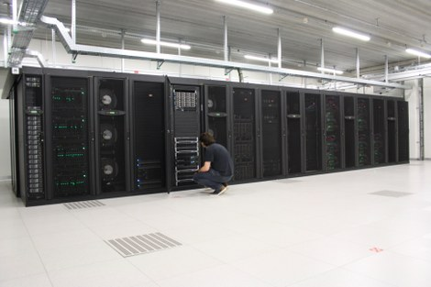
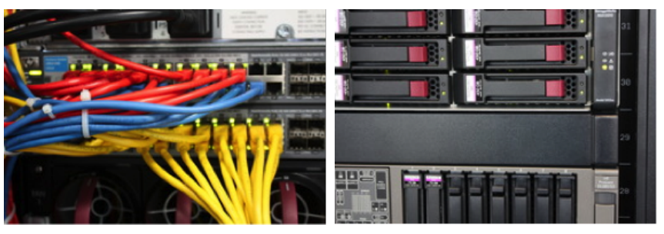
What is UGent-HPC?
Collection of interconnected computers with AMD or Intel CPUs, running Linux operating systems, stored in racks
Parallel-processing technology offering UGent researchers “extremely fast solutions for all their data processing needs”

Slide 7
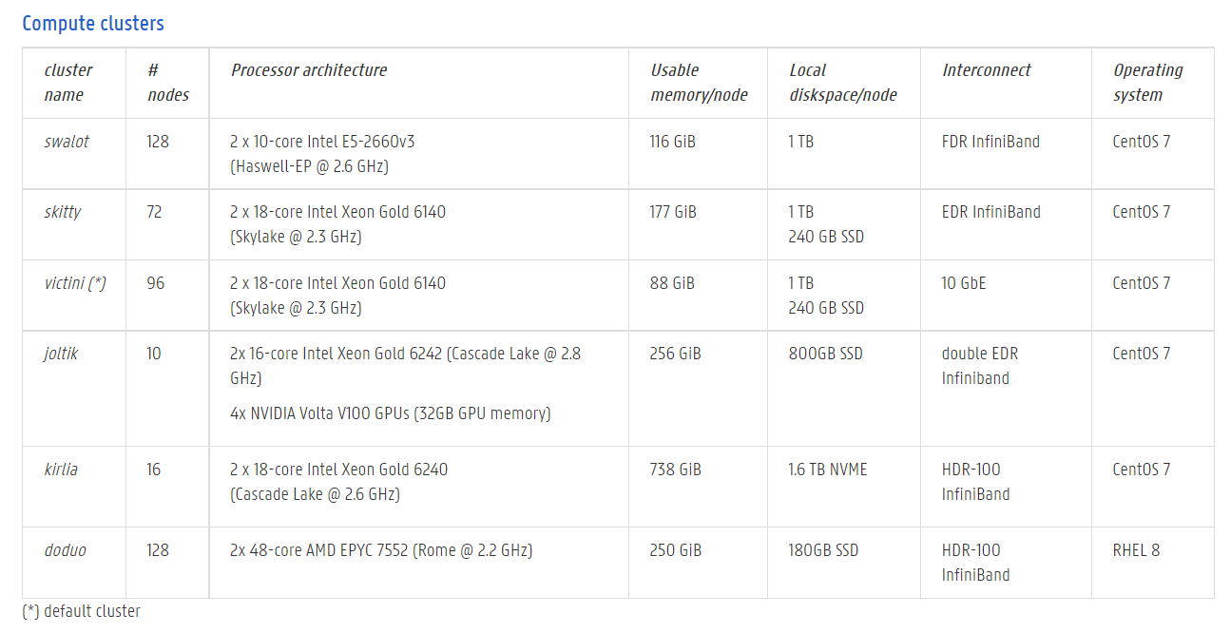
What is UGent-HPC?

Slide 8
Is the HPC a solution for my computational needs?
Sequential program will take equally long on the HPC as on your desktop (as it will only use one core)
strength of HPC comes from its ability to run a huge number of programs in parallel without any user interaction
“running in batch mode”
HPC runs under CentOS 7.9, but users can connect to it from any computer in the UGent network, regardless of operating system
HPC supports C/C++, Java, Python, MATLAB, R, …

Slide 9
Typical HPC workflow
1. Connect to the login nodes with SSH
2. Transfer your files to the cluster
3. Optional: compile your code and test it
4. Create a job script and submit your job
5. Wait while
(a) Your job gets into the queue
(b) Your job gets executed
(c) Your job finishes
6. Download and study the results generated by your jobs

Slide 10
Getting an HPC account

Slide 11
Getting ready to request an account
All UGent researchers/students can request an account on the HPC
Part of the Flemish Supercomputing Centre (VSC)
The UGent HPC uses SSH (secure shell) public/private key pairs for user authentication
Secure connection between two computers via insecure channel (e.g., internet)
Compare to a lock/key pair
The lock (public key) is stored by the VSC
The key (private key) is stored by you
You need your key to the lock to your VSC/HPC account

Slide 12
Getting ready to request an account
Go to https://www.chiark.greenend.org.uk/~sgtatham/putty/latest.html
Download and install (the 64-bit x86 version of) PuTTY (a free SSH client) from the “Package files” section
Launch PuTTYgen
In “Parameters” (at the bottom of the window), choose “RSA” and set the number of bits in the key to 4096
Click on “Generate” and move the mouse cursor over the PuTTYgen window (to generates some random data that PuTTYgen uses to generate the key pair)
For Windows only

Slide 13
Getting ready to request an account
Once the key pair is generated, your public key is shown in the field Public key for pasting into “OpenSSH authorized_keys file”
Fill in the Key comment field to make it easier identifiable afterwards
Specify a (safe!) passphrase in the “Key passphrase” field and confirm it in the “Confirm passphrase” field
For Windows only

Slide 14
Getting ready to request an account
Save both the public (e.g., as “id_rsa.pub”) and private (e.g., as “id_rsa.ppk”) keys in a (safe!) folder on your personal computer with the buttons “Save public key” and “Save private key”
Save an “OpenSSH” version of your private key by entering the “Conversions” menu and selecting “Export OpenSSH key” (do not select the “force new file format” variant). Save the file in the same location as in the previous step with filename “id_rsa”
For Windows only

Slide 15
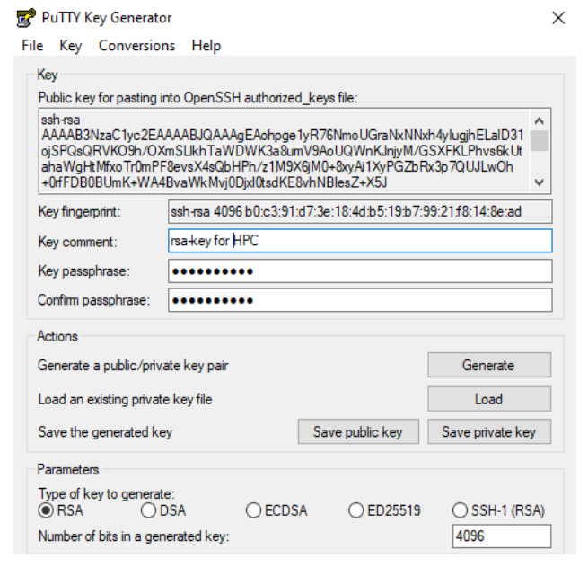
Getting ready to request an account
If all went well, the result should look like this:
For Windows only

Slide 16
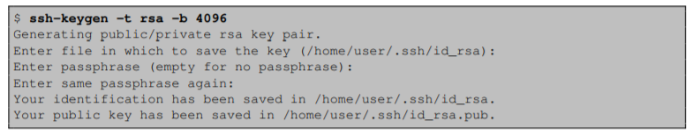
Getting ready to request an account
Open a terminal:
Open the Finder and choose “Applications” > “Utilities” > “Terminal”
Enter “ssh-keygen -t rsa -b 4096”
Choose a filename and a (safe!) passphrase
For Mac only

Slide 17
Applying for the account
Go to https://account.vscentrum.be/
Select “UGent” as your home organization and log in to your UGent account
Upload your public key (i.e., “id_rsa.pub”)
You will receive an email with a link to confirm your email address
After confirming your e-mail address the VSC staff will review, and, if applicable, approve your account
Within one (work) day, you should receive a welcome email with your VSC account details

Slide 18
Connecting to the HPC infrastructure

Slide 19
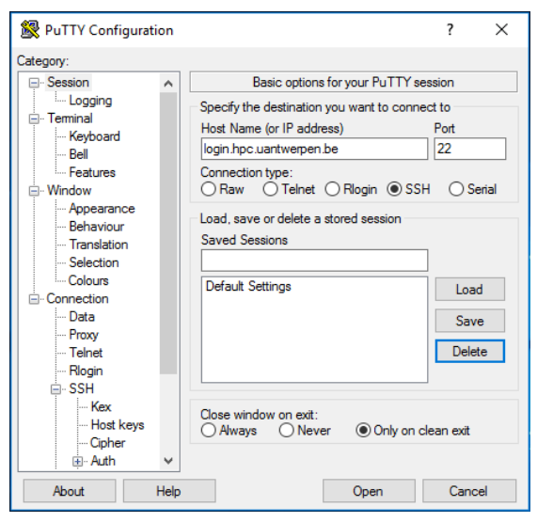
First time connection to the HPC infrastructure
Launch PuTTY and within the category “Session”, in the field “Host Name”, enter the name of the login node of the HPC cluster you want to connect to (i.e., “login.hpc.ugent.be”)
For Windows only

Slide 20
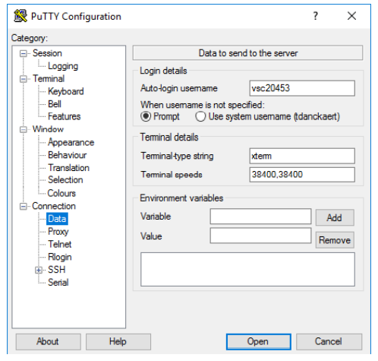
First time connection to the HPC infrastructure
In the category “Connection > Data”, in the field “Auto-login username”, enter the VSC username you received by e-mail
For Windows only

Slide 21
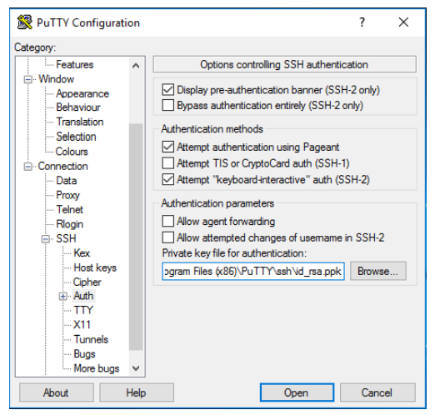
First time connection to the HPC infrastructure
In the category “Connection > SSH > Auth”, in the field “Private key file for authentication” click on “Browse” and select the private key you generated (i.e., “id_rsa.ppk”)
For Windows only

Slide 22
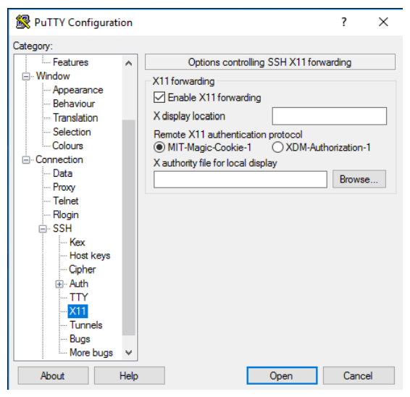
First time connection to the HPC infrastructure
In the category “Connection > SSH > X11”, click the “Enable X11 Forwarding” checkbox
For Windows only

Slide 23
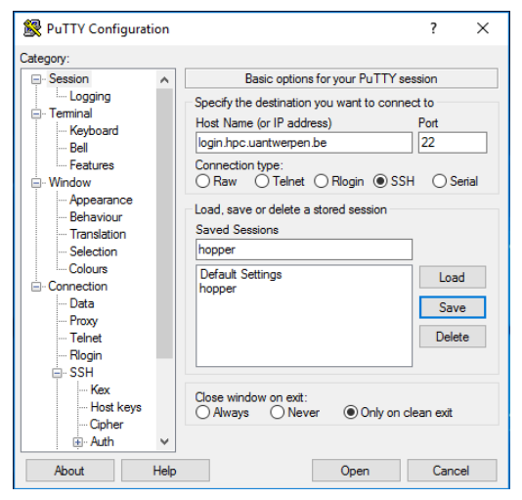
First time connection to the HPC infrastructure
Go back to “Session”, fill in “hpcugent” in the “Saved Sessions” field and press “Save” to store the session information
For Windows only

Slide 24
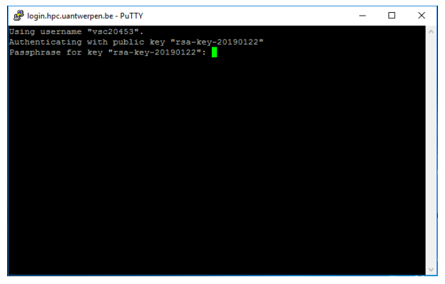
First time connection to the HPC infrastructure
Now pressing “Open” will open a terminal window and ask for your passphrase
For Windows only

Slide 25
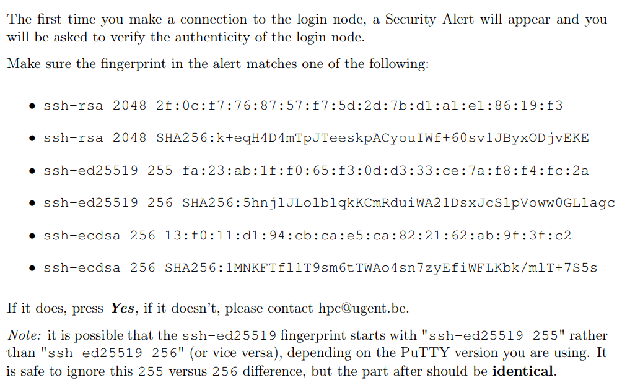
First time connection to the HPC infrastructure
For Windows only

Slide 26
First time connection to the HPC infrastructure
Congratulations! You are now logged in to the HPC infrastructure!
For future PuTTY sessions, just select your saved session (i.e. “hpcugent”) from the list, “Load” it and press “Open”
For Windows only

Slide 27
First time connection to the HPC infrastructure
Open a terminal and enter “ssh vsc43506@login.hpc.ugent.be”
Congratulations, you are now logged in to the HPC infrastructure!
Yes, this took Windows users 8 slides …
For Mac only

Slide 28
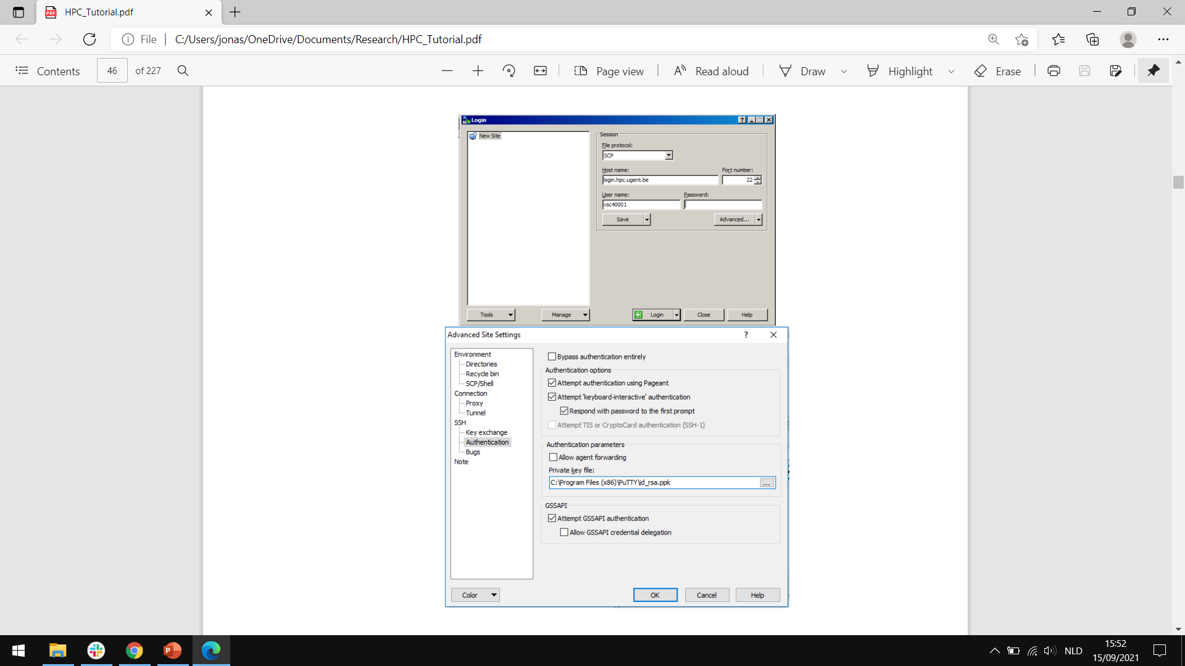
Transfer files to/from the HPC
Go to http://www.winscp.net/
Download and install WinSCP
Open the program
The Login menu is shown automatically (if it is closed, click “New Session” to open it again)
Fill in the necessary fields under “Session”
(a) Click “New Site”
(b) Enter “login.hpc.ugent.be” in the “Host name” field
(c) Enter your username in the “User name” field
(d) Select SCP as the file protocol
(e) Note that the password field remains empty
For Windows only

Slide 29
Transfer files to/from the HPC
(f) Click “Advanced”
(g) Click “SSH Authentication”
(h) Select your private key in the field “Private key file”
For Windows only

Slide 30
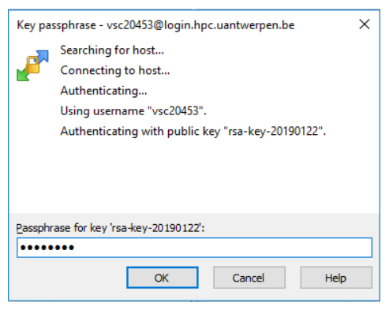
Transfer files to/from the HPC
Press the “Save” button to save the session under “Session Sites” for future access
Click on “Login” and enter your key passphrase
For Windows only

Slide 31
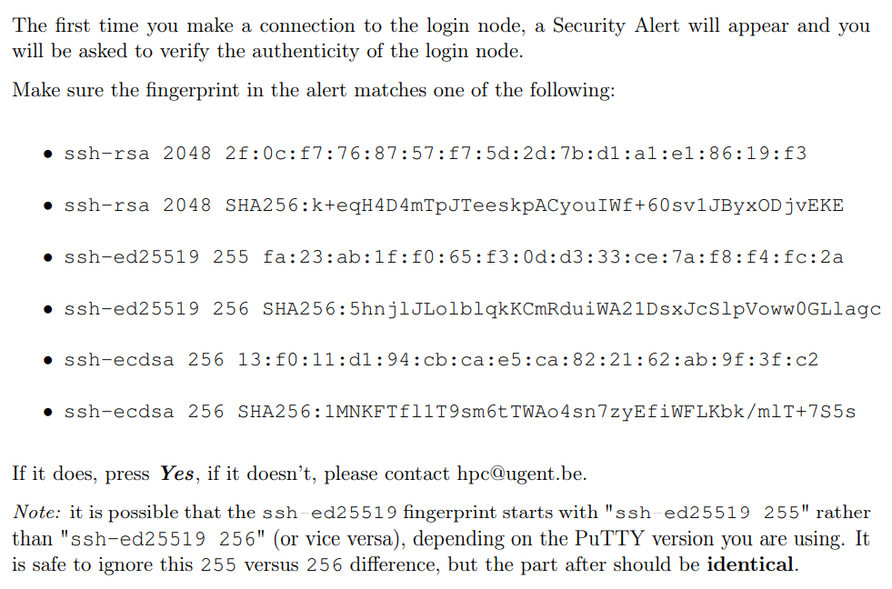
Transfer files to/from the HPC
For Windows only

Slide 32
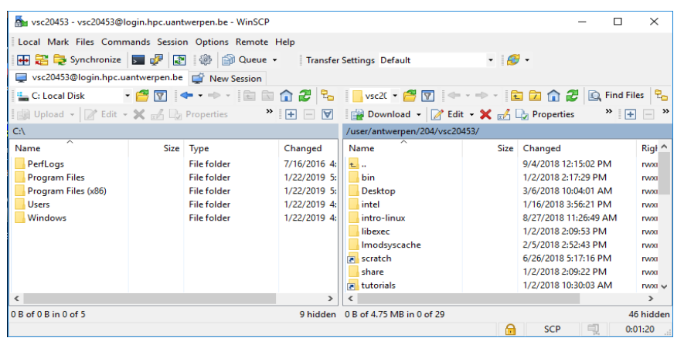
Transfer files to/from the HPC
When you are logged in, you should get something like this
And be able to transfer files from your computer (on the left) to the HPC (on the right) and vice versa
For Windows only

Slide 33
Transfer files to/from the HPC
You could do this in the terminal, using the SCP command
Secure copy (SCP) is a tool for securely transferring files between a local host (your computer) and a remote host (the HPC)
It is based on the Secure Shell (SSH) protocol
If you want to do this, check pages 39-41 of the tutorial (http://hpcugent.github.io/vsc_user_docs/pdf/intro-HPC-mac-gent.pdf)
But using Cyberduck, an SCP GUI, seems easier to me (seems because I am not a Mac user)
Cyberduck can be installed from https://cyberduck.io/
For Mac only

Slide 34
Transfer files to/from the HPC
This is the one-time setup you will need to do before connecting:
After starting Cyberduck, the Bookmark tab will show up. To add a new bookmark, click on the “+” sign on the bottom left of the window. A new window will open.
In the “Server” field, type in “login.hpc.ugent.be”. In the “Username” field, type in your VSC id.
Click on “more Options”, select “Use Public Key Authentication” and point it to your private key
Type in a name for the bookmark in the “Nickname” field and close the window
To open the SCP connection, click on the “Bookmarks” icon and double-click on the bookmark you just created.
You should now be able to transfer files from your computer to the HPC and vice versa
For Mac only

Slide 35
Running batch jobs

Slide 36
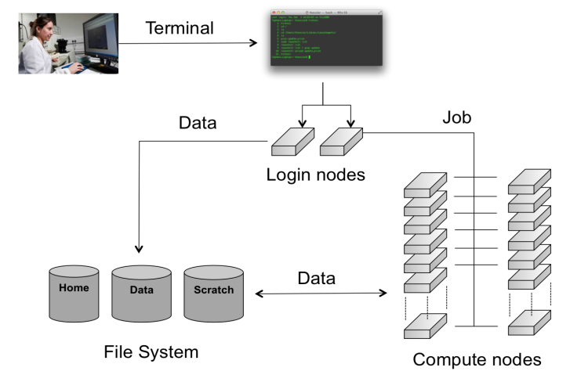
Running batch jobs
The software that handles your batch jobs (i.e., lets you submit, monitor and delete your batch jobs) consists of two pieces:
the resource manager TORQUE
and the job scheduler Moab

Slide 37
Modules
All the software packages that are installed on the HPC cluster require different settings
In order to administer the active software and their environment variables, the module system has been developed, which
Activates or deactivates software packages
Takes care of versioning aspects (only one version can be loaded at a time)
Takes care of dependencies (all dependencies are automatically loaded)
To get an overview of all available software packages on the cluster you are currently logged in to, enter “module available”
To check whether a specific software package (e.g., python) is installed, enter “module av 2>&1 | grep -i -e ‘python’”
The “-i” makes the entry case insensitive

Slide 38
Modules
Not all modules can safely be loaded at the same time
Therefore, the VSC has defined two so-called toolchains
the intel toolchain consists of the Intel compilers, MPI library and math libraries
the foss toolchain consists of the GNU compilers, OpenMPI, OpenBLAS and the standard LAPACK and ScaLAPACK libraries
Toolchains are updated twice a year, which is reflected in their name
E.g., intel-2016a is the first version of the intel toolchain of 2016
The toolchains are used to compile the software installed on the VSC clusters
Only packages compiled with the same toolchain name and version can work together without conflicts!
If you need a software package to be installed on a specific toolchain, you can submit a request for this here: https://www.ugent.be/hpc/en/support
In my experience, they usually install it within one or two days

Slide 39
Modules
So, say you want to use Python
You should first check whether Python is installed on the cluster you are currently logged in to by entering “module av 2>&1 | grep -i -e ‘python’”
If multiple versions are installed, you should load the one you want to use by entering, e.g., “module load Python/2.7.12-intel-2016b”
This command IS case sensitive
You can also unload a package with the “module unload” command or unload them all at once with the “module purge” command
Actually, programming languages (e.g., Python) and standard packages (e.g., NumPy) you don’t have to explicitly load using the “module load” command. Programming languages you can simply specify in front of the name of your executable (see, e.g., “hello_world.pbs”) and standard packages you don’t have to specify at all, you may not even find them using the above command, but if you didn’t have to manually install them on your pc, you can assume that they are installed on the HPC as well.

Slide 40
Getting system information about the HPC
To check the general system state, you can go to https://www.ugent.be/hpc/en/infrastructure/status
To check the state of any one cluster, you can go to http://hpc.ugent.be/clusterstate
You can get the same information, plus information about the nodes in the cluster, about the cluster you are currently logged in to by entering “pbsmon”
By default, we get logged in to the victini cluster, but if this one is too busy or you need more RAM or something, you can swap to a different one by entering, e.g., “module swap cluster/skitty”

Slide 41
Defining and submitting your job
Each time you want to run a program on the HPC, you will need 2 things:
The executable: the program to execute together with its input files (e.g., “hello_world.py”)
A batch job script, which will define the computer resource requirements of the program and will start the actual executable (e.g., “hello_world.pbs”). The HPC needs to know:
1. the number of compute nodes,
2. the number of processors,
3. the amount of memory,
4. the expected duration,
5. the working directory,
6. the necessary modules,
7. and the executable.

Slide 42
Defining and submitting your job
There is no guarantee on when a job will start, since it depends on a number of factors. One of these factors is the priority of the job, which is determined by
historical use: the aim is to balance usage over users, so infrequent (in terms of total compute time used) users get a higher priority
requested resources (amount of cores, walltime, memory, . . . )
time waiting in queue: queued jobs get a higher priority over time
user limits: this avoids having a single user use the entire cluster
Some other factors are how busy the cluster is, how many workernodes are active, …

Slide 43
Defining and submitting your job
You should always request as little resources as possible, since then the scheduler will find a gap to fit the job into more easily
But you should never request less resources than your job will actually need!
If your jobs goes over the amount of RAM or walltime you requested, it will instantly be killed
Check chapter 13 in the tutorial for tips on how to balance these two requirements
Extra tip: if you can, do not wait until the end of your job to save your output, but save whatever you can along the way, to avoid having to start over entirely in case your job gets killed

Slide 44
Defining and submitting your job
When you have submitted a job (or any number of jobs), you can check their status by entering “qstat”, which will return:
Job ID: the job’s unique identifier,
Name: the name of the job,
User: the user that owns the job,
Time Use: the elapsed walltime for the job,
And Queue: the queue the job is in, with:
Q = the job is queued and waiting to start
R = the job is currently running
C = the job is completed (or has been killed)
Okay, let’s run “hello_world.py” on the HPC!

Slide 45
Defining and submitting your job
First, we need to transfer the necessary files to the HPC
The executable: hello_world.py (make sure this one has the necessary permissions by going to properties and selecting all R’s, the first W and all X’s)
Then, we have to create a batch job script: hello_world.pbs
Then, in the terminal, we have to specify our working directory (i.e., where our batch job script is): “cd /user/gent/435/vsc43506/hello_world”
Finally, we can submit our job (“qsub”) and monitor it’s progress (“qstat”)
When it has finished, we can go check the output and error files

Slide 46
Running jobs with Input/Output Data

Slide 47
Where to store your data on the HPC
Your home directory
Default working directory
Path “/user/gent/435/vsc43506”
For batch job scripts, executables and small data files
Little space (3 GB), fast reading and writing
Your data directory
Path “/data/gent/435/vsc43506”
For big data files to be stored for a long time
A lot of space (25 GB), but slow reading and writing

Slide 48
Where to store your data on the HPC
Your scratch directory
Path “/scratch/gent/435/vsc43506”
For big data files to be stored for a short time (i.e., the duration of your job)
A lot of space (25 GB) AND fast reading and writing, but cleared regularly
Only really necessary for heavy input/output jobs (e.g., reading from/writing to a text file thousands of times)

Slide 49
Virtual organizations
Being in a VO allows for larger storage quota to be obtained (provided this can be properly motivated)
Pieter Huycke recently created a VO “vergutslab”, providing us with some 400 GB additional storage space on the HPC (only accessible to members of the VO, of course)
Path “/data/gent/vo/001/gvo00145/data”
To become a member
Go to https://account.vscentrum.be/django/vo/join
Fill in the section “Join VO”
When asked to fill in the VO id, fill in “gvo00145”
After clicking “submit”, the moderator of the VO (i.e., Pieter Huycke) will have to approve your request

Slide 50
Multi-Job Submission

Slide 51
Why parallel programming?
Previous examples would already allow you to run multiple computationally intensive analyses simultaneously without your desktop slowing down for days, but…
There are two important motivations to engage in parallel programming:
The need to decrease the time to solution: distributing your code over N cores holds the promise of speeding up execution times by a factor N
The need to increase the problem size: distributing your code over N nodes increases the available memory by a factor N, and thus holds the promise of being able to tackle problems which are N times bigger
This is what the HPC is for: it has hundreds of nodes and tens of thousands of cores!

Slide 52
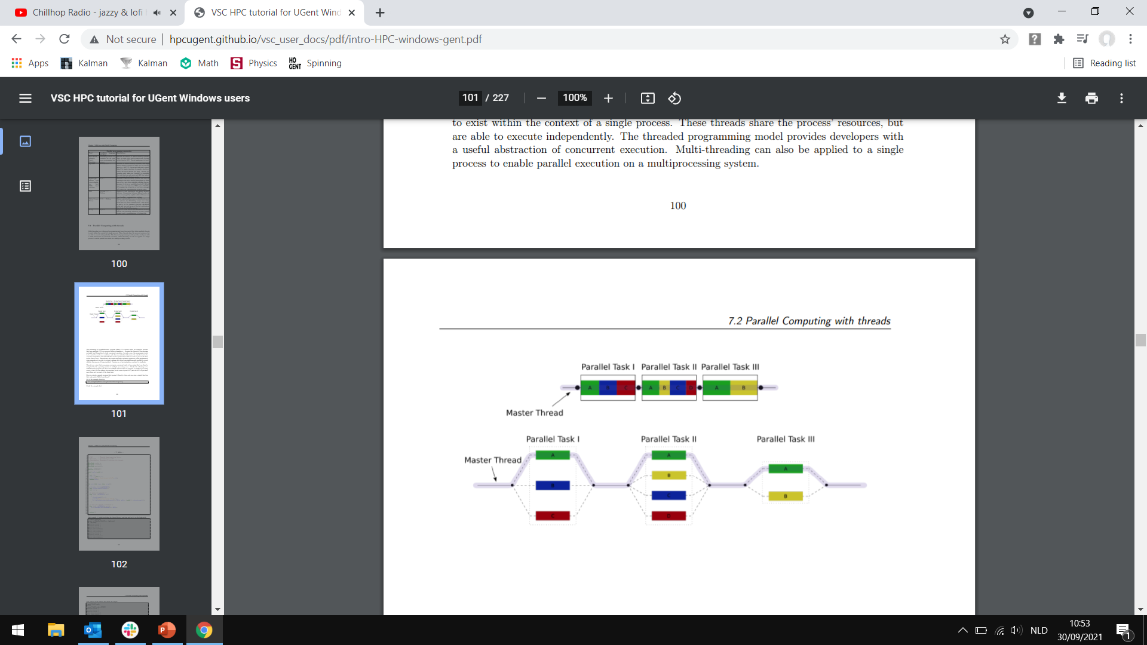
The worker framework
Two possible scenarios:
1. Need to alternate between sequential and parallel computing?
You can use OpenMP or MPI (see chapter 7 in the HPC manual)
Or, if you use Python, you can use Dask (see https://dask.org/ or ask Pieter Huycke)
2. Can make do with (isolated) parallel computing?
You can use (automated) multi-job submission (see chapter 14 in the HPC manual)
I will only cover the latter (since I have no experience with the former)
Sequential scenario
Parallel scenario 1
Parallel scenario 2

Slide 53
The worker framework
A typical example is the “parameter sweep”
Users then often want to submit a large number of jobs based on the same job script but with slightly different parameters settings
One option could be to launch a lot of separate individual small jobs (one for each parameter) on the cluster
This is not a good idea. The cluster scheduler isn’t meant to deal with tons of small jobs. Those huge amounts of small jobs will create a lot of overhead, and can slow down the whole cluster.
Also, it will take you a long time to prepare and submit all the scripts

Slide 54
The worker framework
Instead, you can use the “worker framework”
Designed to handle many small jobs determined by a specific parameter set which is stored in a .csv file
It will launch your many small jobs, but schedule them as one large job
Parameter sweeps:
E.g., run a reward rate simulation with a model with three free parameters for a range of values for each of these parameters
Let’s run “process_parameters.py” (provided by Pieter Huycke)
Job arrays:
When you want to run an analysis on many datasets
E.g., fit a model on data from 100 participants (in isolation from each other)
Let’s run “process_datasets.py” (provided by Pieter Huycke)

